Slide 1

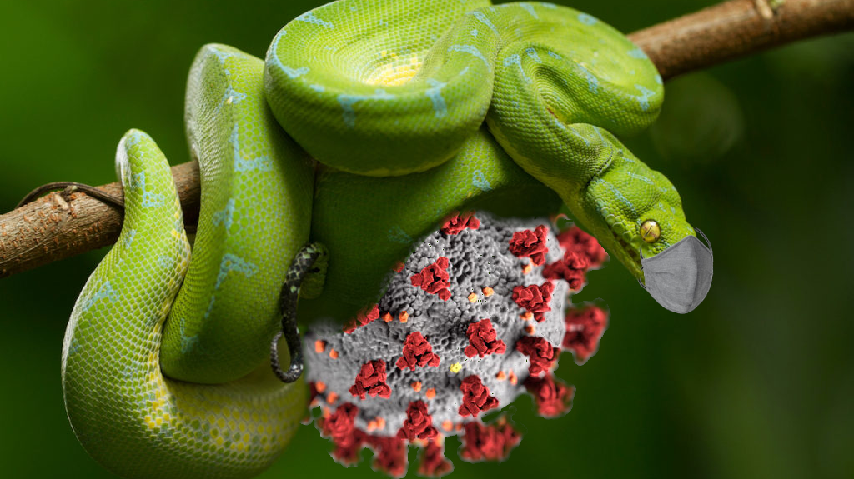
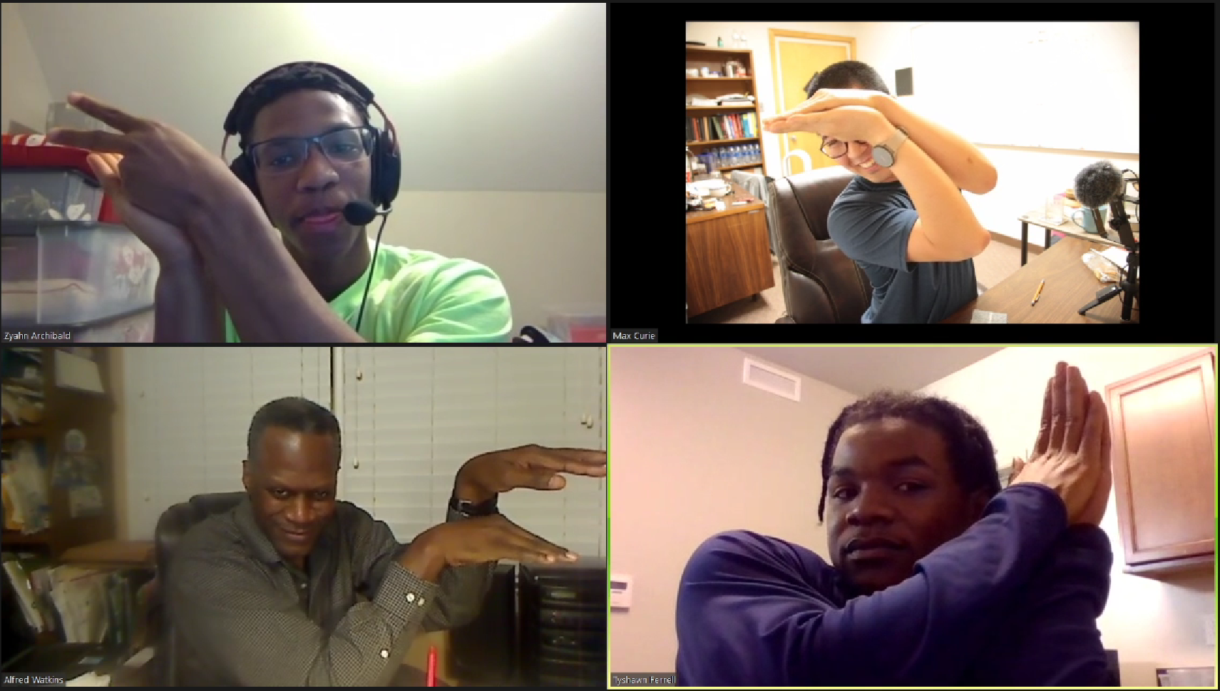
Team name: Silent Python Team member: Zyahn Archibald, Max Curie (Mentor), Alfred Watkins, Tyshawn Ferrell Theme song: Hunter X Hunter

